Slide 1

Class of 2019 Ring Weekend 24 August – 26 August 2018

Slide 2
Schedule of Events
20 AUG [Monday]
1630-1800 Key Leader rehearsal
21-23 AUG [Tuesday-Thursday]
1610-1830 Ring Ceremony rehearsals
24 AUG (Ring Ceremony – Trophy Point) [Friday]
0900- 1500 Ring processing
0900-1200 Ring Accessories pick up
1400- Initial Weather (Uniform)
1500- Ceremony Guard in place/final weather call
1630- First Class formation
1640- Movement to Trophy Point
1700- Retreat
1705- Ring Ceremony
~1710- CMDT remarks
1800- AOG Ring Donor Reception (Ike)
25 AUG (Ring Dinner / Class Reception) – (Ike Hall / Cadet Mess) [Saturday]
1700- Class Reception (Ike Hall)
1730-1830 Commandant's Reception (QTR 101)
1850- Cadets behind chairs (Cadet Mess)
1855- Official party arrives at mess hall steps
1900- Official party entrance
End of Dessert- Speaker remarks
2030- Banquet complete
2045-2230 Optional Hop (Ike Hall)
Leader Ring Presentation
FIRST CAPTAIN ←→ SUPERINTENDENT
CADET CSM ←→ USMA CSM
CLASS PRESIDENT ←→ COMMANDANT
VICE PRESIDENT ←→ USCC CSM
RING COMMITTEE CHAIRMAN ←→ DEAN
CLASS SECRETARY ←→ BTO
Friday Non-Participating Staff and Faculty (spectators) | Friday: Participating Staff & Faculty (e.g. TACs) | Saturday Participating Staff & Faculty in Dinner | Class of 2019 Friday and Saturday | Cadet Support Staff Friday and Saturday
ASU B | ASU Class A, Service Cap, four-in-hand tie | Dress Mess or ASU A w/ bow tie | India White w/ Red Sash, White Hat (no gloves) | White / Gray w/ white gloves and chapel belts

Slide 3
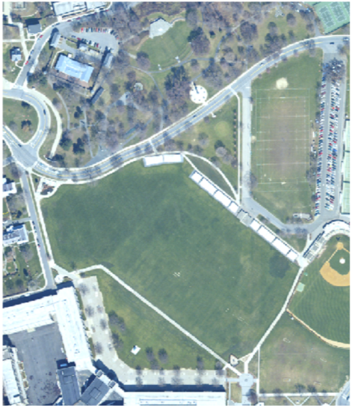
Ring Ceremony
Regimental Movement
TCP
0900- 1500 Ring processing
0900-1200 Pick up Accessories at Cadet Store
1500- Ceremony Guard in place
1630- First Class formation
1640- Movement to Trophy Point
O/O ~1700- Retreat
1705- Ring Ceremony
~1710- COMM remarks
TCP
TCP
THE PLAIN
4TH
3RD
2ND
1ST

Slide 4






Ceremony– Class Movement
Ring Party
RCRs & RTOs
1st CPT
30’
VIPs
D 4
C 4
B 4
A 4
TAC
D 1
C 1
B 1
A 1
13.5’
TAC
NCO
H 4
G 4
F 4
E 4
H 1
G 1
F 1
E 1
C 3
B 3
A 3
I 4
C 2
B 2
A 2
I 1
81’
G 3
F 3
E 3
D 3
G 2
F 2
E 2
D 2
I 3
H 3
I 2
H 2
3rd &
4th Regt
180’
STAIRS
1st & 2nd Regt

Slide 5




Leader Ring Presentation
(1 of 2)
COW
RCC
COW
PRES
Table
CDT DEPCDR
Class VP
AOG
Class President
Chaplain
AOG
CDT CSM
Ring Donor
First Captain
RCC
Class Sec
Ring Donor
BTO
1st RCR
1ST RTO
Dean
2nd RCR
2ND RTO
Ring Donor
USCC CSM
Ring Donor
Podium
3rd RCR
3RD RTO
Ring Donor
COMMANDANT
4th RCR
4TH RTO
Ring Donor
USMA CSM
Glee
Club
Superintendent
4
3
2
1
Guard
Guard
VIP Seating
in front of C4
Ring Tables
Ring Tables

Slide 6
Leader Ring Presentation
(2 of 2)
COW
RCC
COW
PRES
Table
AOG
Chaplain
AOG
Ring Donor
1ST RTO
Ring Donor
1st RCR
BTO
Class Sec
2nd RCR
2ND RTO
Ring Donor
Dean
RCC
Ring Donor
USCC CSM
3rd RCR
3RD RTO
Class VP
4th RCR
4TH RTO
Ring Donor
COMMANDANT
Class President
Ring Donor
USMA CSM
CDT CSM
Glee
Club
Superintendent
First Captain
4
3
2
1
Guard
Guard
VIP Seating
in front of C4
Ring Tables
Ring Tables

Slide 7
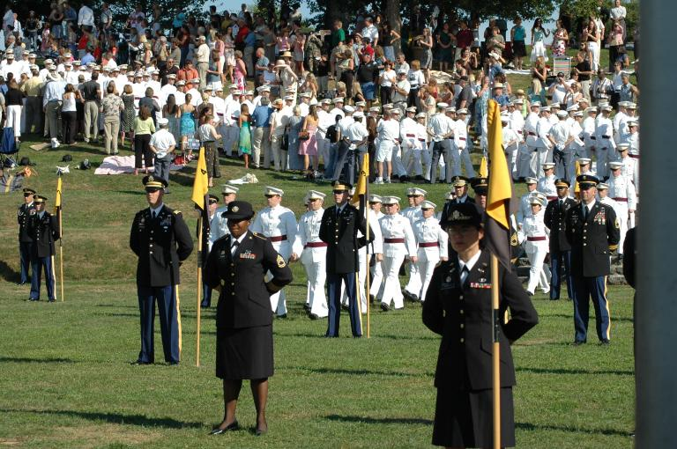
Occupation (1 of 2)
TAC Teams Occupy Formation Area with CO guidons

Slide 8
Ring Ceremony Step by Step.
1640: VIP’s are in position on the stage. All company TACs with Guidons and TAC NCOs are in position on the grass in front of the Amphitheater. The First Class steps off from the Apron for Trophy Point.
The company’s march in to position with their TAC. The Company Commanders command the halt, facing movement, and parade rest.
1700: The Ring and Crest Chainman (RCC) makes opening statement for retreat and invocation.
Retreat-Cannon-RCC calls “First class attention” “Present Arms”
To the colors- “Order Arms” “Parade Rest”
RCC intro Chaplain- invocation
RCC “Ladies and Gentleman, take your seats”, remarks.
RCC “Class Attention” Intro Commandant
Commandant “At Ease”, remarks.
RCC “Class, Attention”, “Ring and Crest Reps…Post!”
Company Reps, Regiment Reps and RTOs move to their respective tables. TAC NCOs move along side their TACs.
RTO’s issue ring boxes to Company Reps. Leader Team rings issued to VIPs on stage. Company Reps return to position next to their TAC NCO.
RCC “Companies, you may distribute your rings!”
1st CPT, CDT CSM, Class President, Class VP, RCC, and Class Secretary post themselves in front of their respective ring presenter. Rings issued, TAC NCO retains case and returns to position behind company. TACs return to position. All movement stops.
RCC “Class of 2019, you may don your rings” Movement has stopped.
RCC “First Class, Attention, un-cover” “Ladies and Gentlemen, please stand and uncover for the singing of the Alma Mater.” Alma Mater complete.
RCC “First Class, Re-cover.” “Class Dismissed”
TAC NCOs return ring boxes to REG ring tables. Chaos ensues.

Slide 9
Occupation (2 of 2)
FRONT
A
CO CDR
TAC
RCR
Z
TAC NCO
Company formation is organized alphabetically by last name with the exception of the Company Commander and Ring and Crest Rep (RCR) Space determined
by actual class size per company

Slide 10
Company Ring Presentation (1of5)
CUE: “Ring and Crest Reps…Post!”
STAGE
RCR
TAC
TAC NCO
TAC NCO opens ring box when RCR returns from stage.
TAC NCO moves along side TAC.

Slide 11
Company Ring Presentation (2of5)
CUE: “Companies, you may distribute your rings!”
STAGE
RCR
TAC commands “One step forward, march” him/herself and TAC NCO.
TAC
TAC NCO

Slide 12
Company Ring Presentation (3of5)
“Companies, you may distribute your rings!”
STAGE
TAC
TAC NCO
RCR
TAC commands “About, face” for him/herself and TAC NCO.
RCC executes a Right Face on the TAC’s About Face!

Slide 13
Company Ring Presentation (4of5)
STAGE
TAC
TAC NCO
RCR
TAC, TAC NCO and RCR move down the ranks as if conducting an inspection while handing out the rings.

Slide 14
Company Ring Presentation (5of5)
All rings have been handed out.
STAGE
CO CDR
TAC
TAC returns to original position.
TAC NCO retains ring case and returns to original position.
RCR returns to original position.
ALL facing the stage.
RCR
TAC NCO

Slide 15
Uniform : As per rank (Chapel belt vs Red Sash)
Ring Poop ROE
Pick up Ring Accessories 0900-1200 at C-Store
TAC Inventory 25 1500 AUG 18
Remove “Battle Rings”
Work W/ Company RCC for cadets abroad
Class Privileges memo
Tracking plebes have not received India whites or Full dress, they shouldn’t be going anyways.
RXL starts Monday @1610 for Key Leaders

